Slide 1
Lane-Level Positioning Using Markov Localization
Group
Yagnesh Bhadiyadra(1641002)
Nisarg Sheth(1641015)

Slide 2
Background and Motivation
The current GPS navigation is not so accurate to provide lane level navigation.
There had been efforts to achieve this using image processing algorithms and/or costly equipments such as highly accurate sensors, high performance computers, etc. , but it becomes too much complicated and costlier.
So with that in mind we are addressing this problem with the help of Markov based localistation.

Slide 3
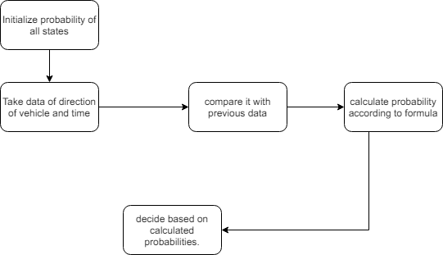
Block diagram

Slide 4
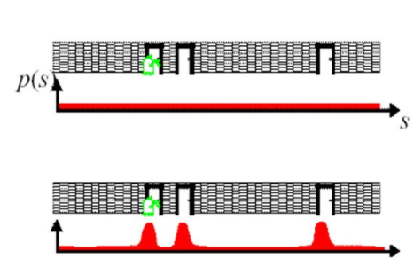
PRP concepts used
We used conditional probability, markov localization concepts.
We also used total probability theorem.

Slide 5

Pseudo code
Compare the direction with the previous direction.
Calculate the value of distance deltaD.
See from the look up table the value of probability for the given deltaD .
Put the values in the given formula.

Slide 6
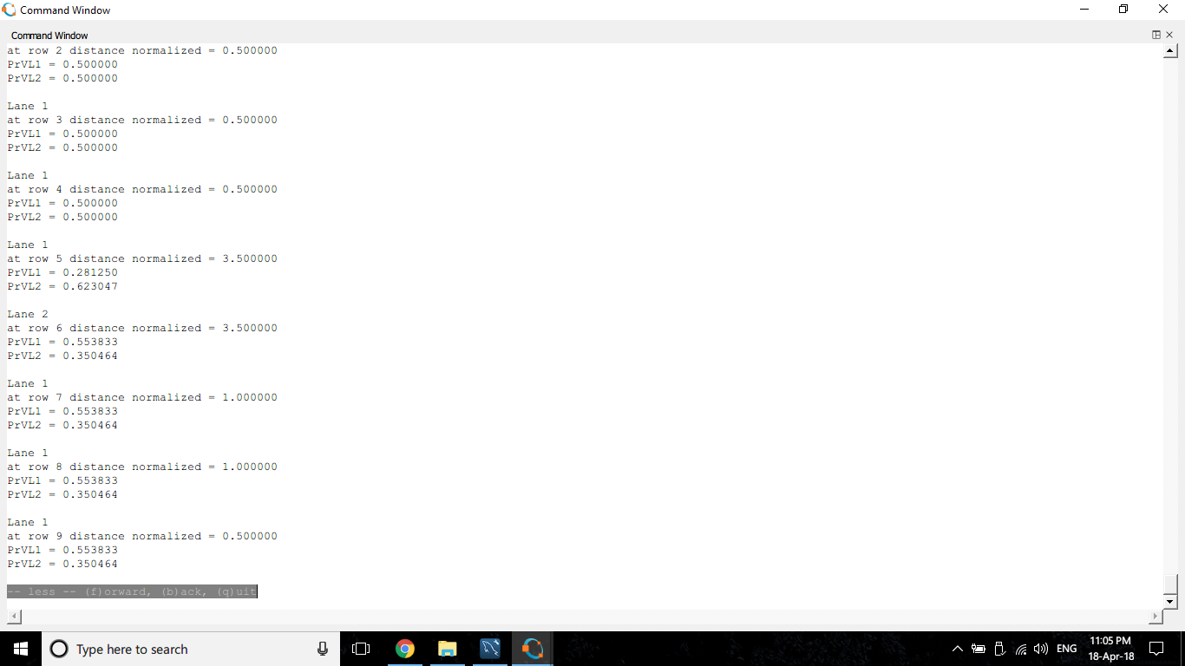
Result

Slide 7
Future scope
Currently we are predicting the lane changing on the basis of only markov localization and hence we might get some incorrect results. So we can use other techniques such as computer vision along with markov localization to get precise results. Also we will have to develop some solution to this problem at the crossroads and at the sharper curves on the roads where the algorithm may predict a lane change even if it is not.

